Slide 1
WELCOME TO BUDGET NINJA
Presented by : Issac (leader), Mengpei, Tim, Winnie, Jarret, Saurav, Mohit, Yi

Slide 2
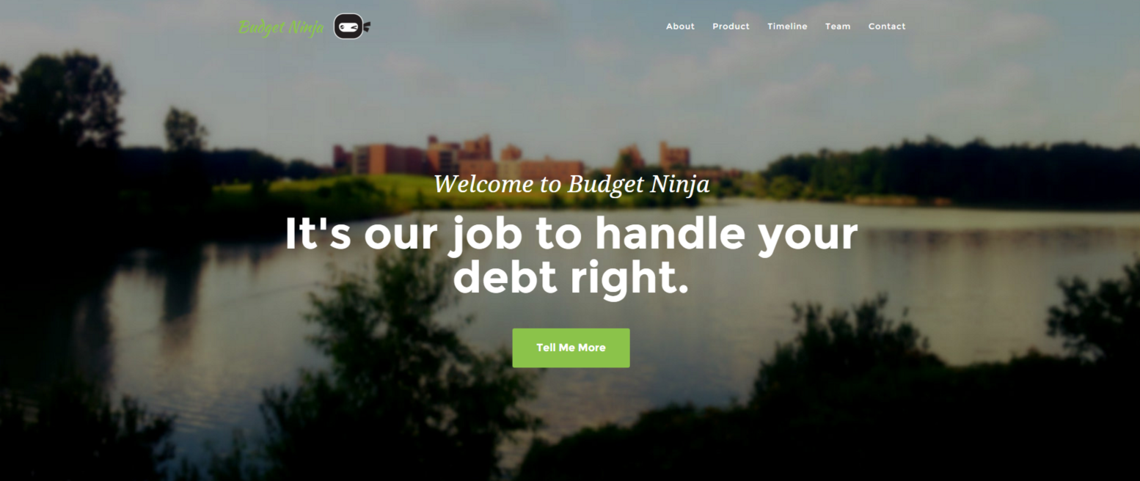
OUR GROUP WEBSITE
http://budgetninja.github.io/

Slide 3




OUR APPLICATION

Slide 4
WHAT IS FAIRWELL?
Fairwell is an app that helps solving your debt issues with friends and family
How?
Keep tracks of all the expenses with friends (shopping, dinner, game, etc…)
Various options for creating a statement
Statement description, total amount, who is the payer of the event, date of event, deadline for the event, add snapshot, add additional note…
View statements and resolve statements and etc.

Slide 5
WHY FAIRWELL?
“Farewell” (Goodbye, my friend!)
Or “Fare” (price, cost, fee…) “Well” (nicely)
Or “Fair” (equally, impartially) “Well” (nicely)

Slide 6
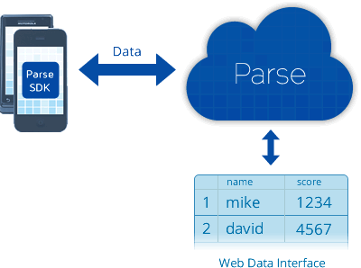
BACKEND SOLUTION

Slide 7
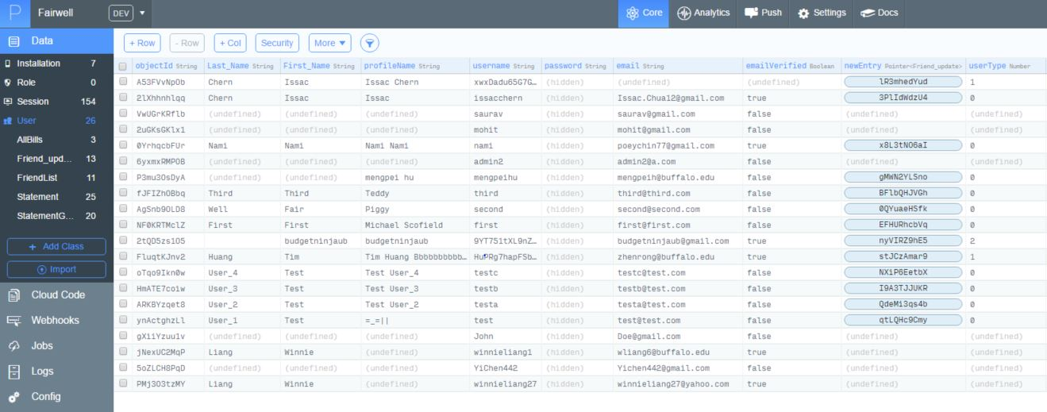
SNEAK PEEK OF PARSE DATABASE

Slide 8
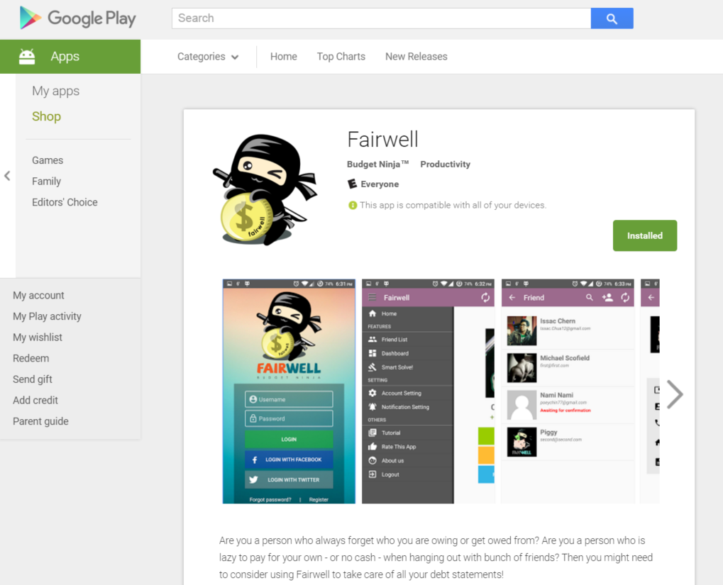
AVAILABLE ON GOOGLE PLAY (BETA)
https://play.google.com/store/apps/details?id=io.github.budgetninja.fairwellandroid

Slide 9

APP DEMO TIME!
APP DEMONSTRATION

